Slide 1
Face Recognition based Attendance System using Machine Learning

Slide 2
ABSTRACT
The goal of this project is to create a new attendance system based on real-time facial recognition. This project aims to develop a face recognition-based attendance system using machine learning techniques. The proposed system utilizes Python programming language and KNeighbors Classifier algorithm for face recognition. The proposed system recognizes and encodes the unique traits of the faces in the database into a pattern image.

Slide 3
EXISTING SYSTEM
The existing system for attendance management involves manual methods where teachers call out students and mark their attendance accordingly. However, these traditional techniques are time-consuming and tedious for both teachers and students. Moreover, it leaves room for errors and inaccuracies in the attendance records due to various reasons such as illegible handwriting, incorrect marking, or proxy attendance.

Slide 4
In addition to the time-consuming and error-prone nature of the existing system also lacks real-time monitoring and tracking of attendance. This can lead to delays in identifying students who may have missed classes or arrived late.
Some of the existing system requires additional hardware for the attendance system.

Slide 5
DISADVANTAGES OF EXISTING SYSTEM
Time-consuming: The process of calling out students one by one and marking their attendance manually can be a time-consuming task, particularly in large classes.
Inaccurate: The traditional attendance system is prone to errors and inaccuracies due to various reasons such as illegible handwriting, incorrect marking, or proxy attendance.

Slide 6
Lack of real-time tracking: The traditional attendance system does not provide real-time monitoring and tracking of attendance, which can lead to delays in identifying students who may have missed classes or arrived late.
Difficult to manage: Managing attendance records manually can be a cumbersome task, particularly for teachers who have to deal with large class sizes.

Slide 7
Lack of security: Paper-based attendance records can be misplaced or stolen, which can compromise the security and privacy of the attendance data.
Inefficient: The traditional attendance system does not provide an efficient way to manage attendance data and generate reports, which can lead to delays and errors in the attendance management process.

Slide 8
PROPOSED SYSTEM
The proposed system is a face recognition-based attendance system using machine learning techniques. The system aims to automate the attendance management process by capturing facial images of individuals and verifying their identity using machine learning algorithm: KNeighbors Classifier.

Slide 9
The primary objective of the proposed system is to automate the attendance management process by capturing facial images of students and storing them in a database. The system is designed to accurately detect and recognize all facial features of each student, including their seating position and posture, ensuring that attendance is marked correctly. Unlike the traditional attendance system, where teachers need to manually call out and mark attendance, the proposed system records a video of the class and uses advanced processing techniques to detect and recognize the faces of students.

Slide 10
Once the face of each student is recognized, the attendance database is automatically updated, eliminating the need for manual attendance marking. The proposed system provides a convenient and efficient way to manage attendance records, reducing the workload on teachers and ensuring accurate attendance data. The attendance is marked in the .csv file and stored with the details.

Slide 11
ADVANTAGES OF PROPOSED SYSTEM
Accurate attendance marking: The proposed system uses advanced machine learning techniques and facial recognition technology to accurately mark attendance, eliminating errors and inaccuracies associated with manual marking.
Real-time tracking: The system provides real-time monitoring and tracking of attendance, allowing for immediate identification of students who may have missed classes or arrived late.

Slide 12
Time-saving: The proposed system automates the attendance management process, eliminating the need for teachers to manually call out and mark attendance, saving valuable classroom time. The Proposed system proved to be an efficient and robust device for taking attendance in a classroom without any time consumption and manual work.
Efficient: The proposed system provides an efficient way to manage attendance data and generate reports, reducing the workload on teachers and administrators. The proposed system developed is cost-efficient and need less installation.

Slide 13
Secure: The proposed system uses advanced security features to ensure the privacy and security of attendance data, reducing the risk of data theft or loss.
Scalable: The proposed system is scalable and can handle large volumes of data, making it suitable for use in schools, colleges, and other educational institutions with large class sizes.

Slide 14
Convenient: The proposed system provides a convenient way for students to mark attendance, eliminating the need for manual marking and reducing the time spent on attendance management. The proposed system doesn’t require any additional Hardware.

Slide 15
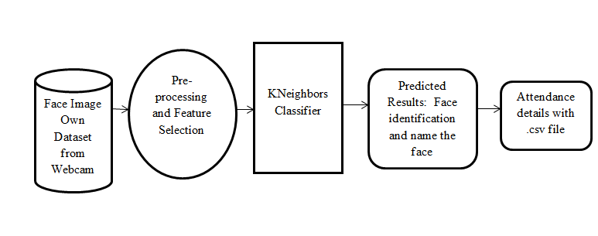
SYSTEM ARCHITECTURE

Slide 16
HARDWARE REQUIREMENTS
System : Pentium i3 Processor.
Hard Disk : 500 GB.
Monitor : 15’’ LED
Input Devices : Keyboard, Mouse
Ram : 4 GB

Slide 17
SOFTWARE REQUIREMENTS
Operating system : Windows 10.
Coding Language : Python
Web Framework : Flask

